Slide 1

Research Methods
Course Instructor: Summayyah Shafique

Slide 2
Psychology is a Science
Science is defined as method of studying nature that involves the collecting of data to test hypothesis.
The main difference between psychology and physics, chemistry or biology is that the former studies human behavior, while the others study nonorganic phenomena and chemical and biological processes.
Psychologist develop hypotheses or prediction based on theories or past observation.
They then collect data to test hypothesis is correct.

Slide 3

What is Research?
Research is a scientific method through which we measure behavior or any phenomena of interest. Collecting information (or data) is an important aspect of research.

Slide 4
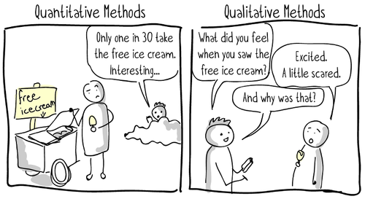

Slide 5
Steps of the research process
Step I: Develop a research question
Step II: Generate research hypothesis
Step III: Form operational definitions
Step IV: Chose a research design
Step V: Evaluate the ethics of your research design.
Step VI: Collect & analyze data: form your conclusions
Step VII: Report research results

Slide 6
Theory and Hypothesis
Theories are broad explanations and predictions concerning phenomena of interest. They provide a framework for understanding the relationships among a set of otherwise unorganized facts or principles.
All of us have developed our own informal theories of human behavior, such as “People are basically good” or “People’s behavior is usually motivated by self-interest.”
A hypothesis is a prediction stated in a way that allows it to be tested. Hypotheses stem from theories; they help test the underlying soundness of theories.

Slide 7
Research Methods:
Survey Method
Observational Method
Correlational Method
Experimental Method
Case Study
Archival Research

Slide 8
Survey Method:
Survey research is used to assess people’s thoughts, opinions and feelings. A descriptive method in which participants are asked a series of question or respond to a series of statements about some topic. Survey methods includes:
Mail survey
Telephonic survey
Personal survey
Internet survey

Slide 9

1. Mail survey
The questionnaire received through the mail. It is also called self -administered questionnaires.
Advantages
Inexpensive
Wide number of people
Respondent to fill it out at their own convenience
This is the only kind of survey you can do if you have the names and addresses of the target population.
Disadvantages
Response rates
Less reliable for asking for detailed written responses
Cannot probe if needed.

Slide 10

2. Electronic Surveys
These are interviews in which the interviewees enter their own answers directly into a computer. Online survey is a simple, inexpensive way to collect evidence and gather customer opinions and preferences.
Advantages
Efficient
Low cost
Obtain survey responses from a large number of people.
Just point and click
Online questionnaires are paperless.
Convenient for the responder
Diverse sample
Disadvantages
How to sample people?
Lack of control
Response and selection biases

Slide 11

Interviews 1. Telephone Interview
Interview through telephone becoming famous day by day for brief surveys.
Advantages
Gather information rapidly
High response rate
They allow the interviewer to ask follow-up questions.
No field staff is necessary
Disadvantages
Cannot observe the body language.
Costly

Slide 12

2. Personal Interviews:
Interviews are a far more personal form of research than questionnaires. In the personal interview, the interviewer works directly with the respondent. An interview is called personal when the interviewer asks the questions face-to-face with the interviewee.
In this type of survey interviews typically conducted in high-traffic locations such as shopping malls. They allow you to present people with samples of products, packaging, or advertising and gather immediate feedback.
Advantages
Opportunity to probe.
Easier for the respondent
High response rate.
Disadvantages
Time consuming
Needs training
Expensive

Slide 13
Observations
Observation
Observation
with intervention
Observation
without intervention

Slide 14
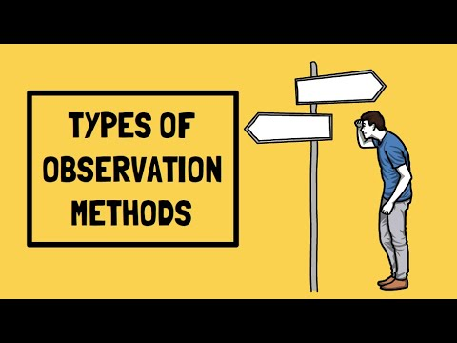
Scientific Observation
Scientific observation is made under precisely defined conditions in a systematic and objective manner with carefully record keeping.
The primary goal of observation is to describe behavior fully and accurately.
Types of Observations
Observation without intervention
Observation with intervention

Slide 15
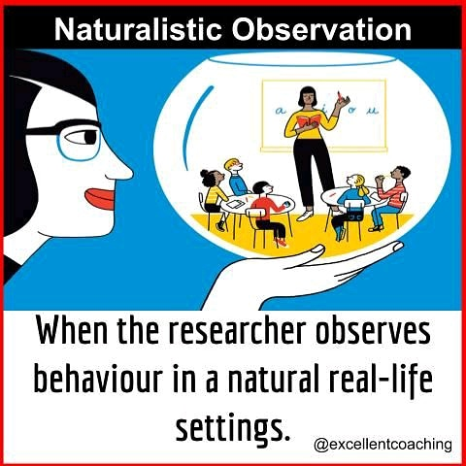
1. Naturalistic Observation\ Observation without Intervention.
Carefully and systematically watching behavior as they occur naturally. With no involvement from the observer.
“A natural setting as one in which behavior ordinarily occurs and one that has not been arranged specially for the purpose of recording behavior”.
For example, the teacher can observe the behavior of his student in the playground or in any other social gathering without making him conscious. Natural observation can be done anywhere without any tools.

Slide 16
2. Observation with Intervention
Structured Observation: A method of observation where the researcher creates a situation where a behavior can occur. They set up a situation where they might be able to see the behavior, they’re interested in. Put people in a specific situation, then see what happens.

Slide 17

Archival Method
Archival research is research that involves searching for and extracting information and evidence from original archives.
Archives are historical – non-current – documents, records and other sources relating to the activities and claims of individuals, entities or both.
census documents, college records, online databases, and newspaper Clippings
Advantages
It saves a lot of time which would otherwise be spent on travelling, surveys, interviews, etc.
It is a cost-effective method of research as compared to other research options.
Limitations
It may take hours or days to find the right document or information needed for research.
Archival sources may not be available or accessible

Slide 18
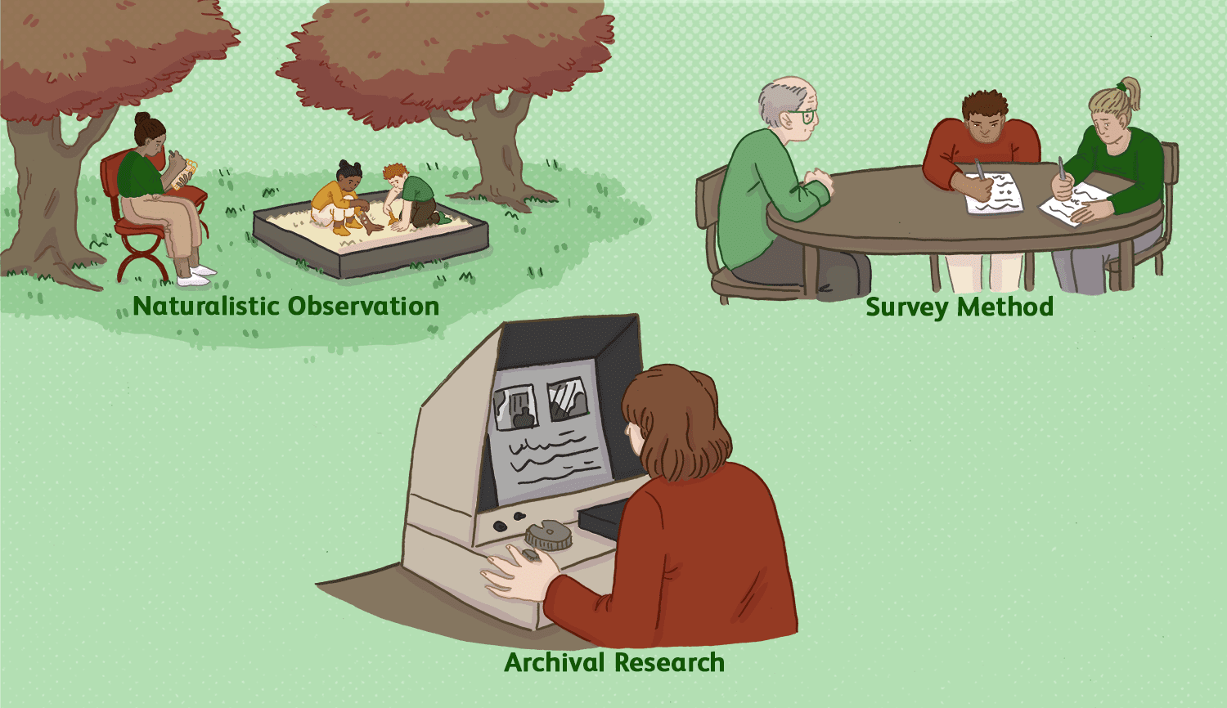

Slide 19
Correlational Method
The correlational method involves systematically measuring the relationship between two or more variables (e.g., how much one can be predicted from the other).
Surveys: The correlational method often relies on surveys, as well as on observational data. Surveys are used when the variable of interest is not easily observable.
Positive correlations indicate that an increase in one variable is associated with an increase in the other. For example, (1) the more time you spend running on a treadmill, the more calories you will burn (2) Those who suffer from mental illness tend to have higher rates of suicide than those who do not.
Negative correlations indicate that an increase in one variable is associated with a decrease in the other. For example, (1) there is a negative correlation between self-esteem and depression. The higher our self-esteem, the lower our feelings of depression (2) The more that people are vaccinated for a specific illness, the less that illness occurs (Covid-19).

Slide 20
Experimental Method:
A scientific method that seeks to confirm cause and effect relationships by introducing independent variables and observing their effects on dependent variables.
An independent variable is a condition set or selected by an experimenter to see whether it will have an effect on behavior; it might be a stimulus presented, a drug administered, and a new method of training business managers and so on.
Dependent variable is so called because its value depends on the value of the independent variable.
Measuring effect of aggression caused by a violent videogame (Pubg)/ Coffee and sleep or performance.
An experimental group consists of participants exposed to the independent variable. Members of control group are exposed to all conditions except the independent variable.
Example
Suppose you notice that you seem to study better while listening to your iPod. This suggests the hypothesis that music improve learning. We could test this idea by forming an experimental group that studies with music. A control group would study without music. Then we could compare their scores on a test. The control group provides a point of reference for comparison. If the average test scores of the experimental group is higher than the average test scores of control group than we can conclude that music improves learning.

Slide 21
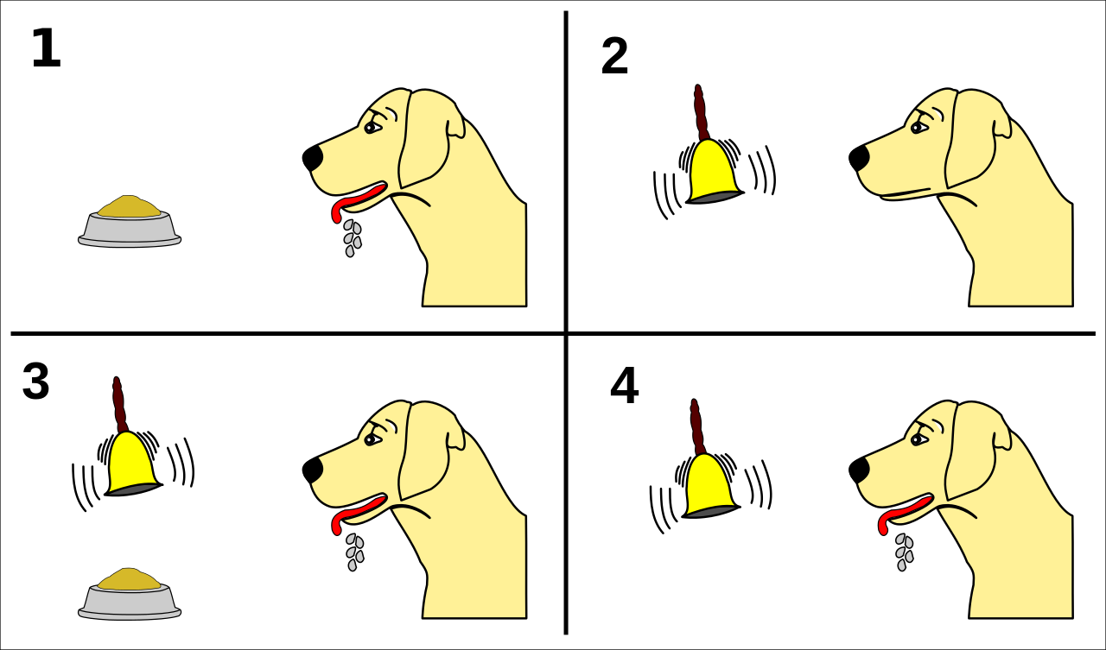

Slide 22

Example
Independent and dependent variables. You design a study to test whether changes in room temperature have an effect on math test scores.
Your independent variable is the temperature of the room. You vary the room temperature by making it cooler for half the participants, and warmer for the other half.
Your dependent variable is math test scores. You measure the math skills of all participants using a standardized test and check whether they differ based on room temperature.

Slide 23
Clinical method or Case study methods
Intensive description and analysis of individual. Case studies are a source of hypothesis and ideas about normal and abnormal behavior.
It includes interviewing the subjects, interviewing people who are close to the subjects, direct observation of the participants, examination of records, and psychological testing.
Case studies of terrorists might help identify others who are prone to violence.

Slide 24
Research Ethics

Slide 25
Five ethical principles
Protection from harm
Right to privacy
Deception
Informed consent
Debriefing

Slide 26

Informed Consent
Agreement to participate in an experiment,
granted in full awareness of the nature of the experiment, which has been explained in advance.
An informed consent form provides a written description of what participants can expect during the experiment, including potential risks and implications of the research.
It also lets participants know that their involvement is completely voluntary and can be discontinued without penalty at any time.
Furthermore, the informed consent guarantees that any data collected in the experiment will remain completely confidential.
In cases where research participants are under the age of 18, the parents or legal guardians are required to sign the informed consent form.

Slide 27

Confidentiality:
Participants should remain anonymous so that data cannot be identified as theirs names should be withheld when data is reported.
Information about a person acquired during a study must be kept confidential and not made available to others without the research participant’s consent.
A common practice is to separate the names and other information used to identify participants from the data collected in the study. The data are then identified only by code or case numbers.
In that way, no one other than the experimenter has access to how any particular participant responded.
Another common practice is to report only aggregated data for example, data averaged across all participants in the same group or condition. This further protects the privacy of individual research participants.

Slide 28

Minimal Risk
In most cases, the risks anticipated in the research should be no greater than those ordinarily encountered in daily life.
Obviously, a person should not be exposed to physical harm or injury, but deciding how much psychological stress is ethically justified in a research project is not always so clear-cut.

Slide 29
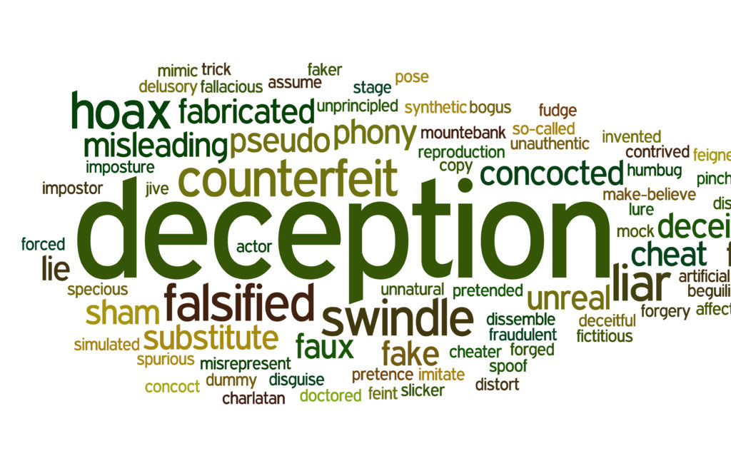
Deception
Social psychological research involves misleading participants about the true purpose of a study or the events that transpire.
Note that not all research in social psychology involves deception.
Deception is discouraged
Incase it is used, debriefing should be done

Slide 30

Debriefing
When deception is used in a study, the post-experimental interview, called the debriefing session, is crucial.
Debriefing is the process of explaining to the participants, at the end of an experiment, the true purpose of the study and exactly what transpired.
If any participants have experienced discomfort, the researchers attempt to undo and alleviate it. During debriefing too the participants learn about the goals and purpose of the research.
The best researchers question their participants carefully and listen to what they say, regardless of whether or not deception was used in the experiment.

Slide 31
Questions?

